Slide 1


SIMple storage services

Slide 2
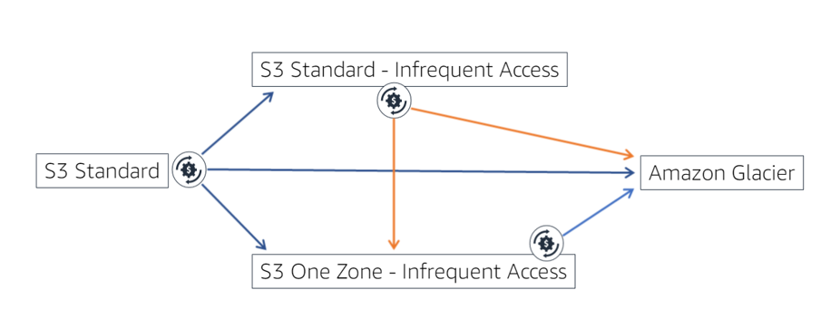

Life cycle

Slide 3
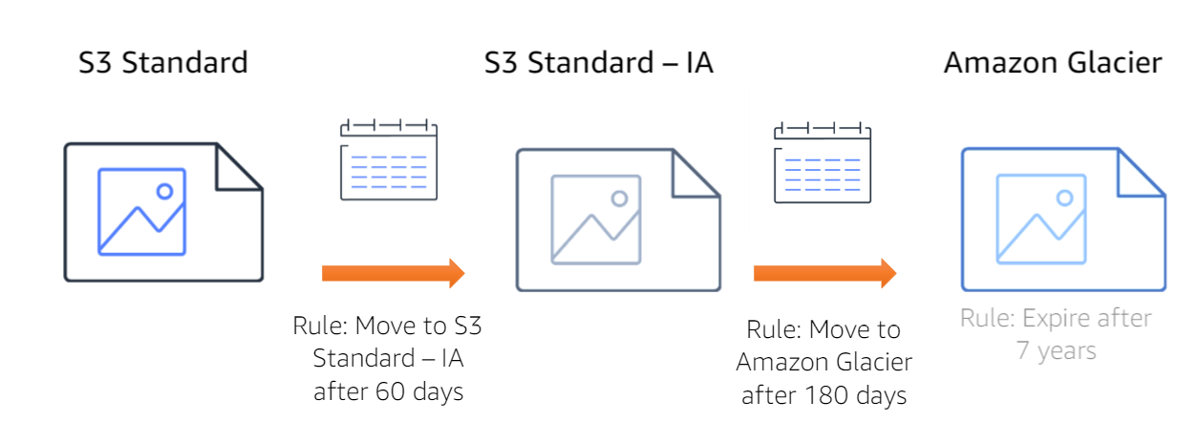
Life cycle - Storage classes

Slide 4
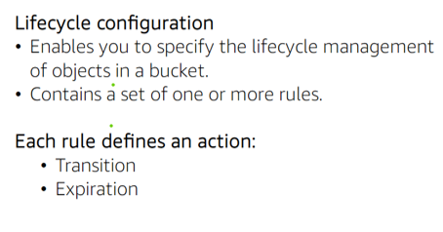
Life cycle - Storage classes

Slide 5
Life cycle
automate transitions
Considerations:
No automatic transition tables for object size less than 128KB to Standard IA or One Zone IA
Data to remain in 1 storage for atleast 30 days before it moves to the Standard or the One Zone IA
Data can be moved in directly in the Glacier from any class.

Slide 6
Life cycle
Action types
Perform the action like:
Transition – Move from STANDARD_IA or ONEZONE_IA or GLACIER etc. based on specifications
Expiration – Delete the object after specified time

Slide 7
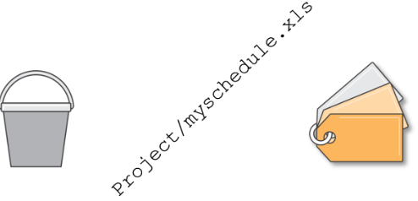
Life cycle
parameters
Set the life cycle configurations for the bucket, prefix of for the object tags.

Slide 8
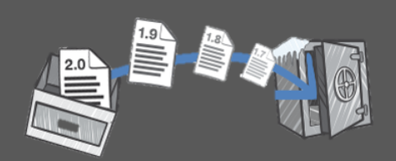
Life cycle
versions
Life cycle configuration can be managed for the particular version.
Current of the previous versions.

